Slide 1
CS 316: Introduction to Deep Learning
Probability Overview
Week 3
Dr Abdul Samad

Slide 2
Lecture Outline
Motivation
Examples
Basic probability theory
Probability Mass Function (PMF)
Probability Density Function (PDF)
Common Probability Distributions
Sampling Probability Distributions

Slide 3
Motivation
Machine Learning is a lot about probabilities.
Many times in machine learning what you want to do is, calculate a probability of something given some other factors.
Examples:
Image Recognition
Classification
Sentimental Analysis
Generative Models

Slide 4
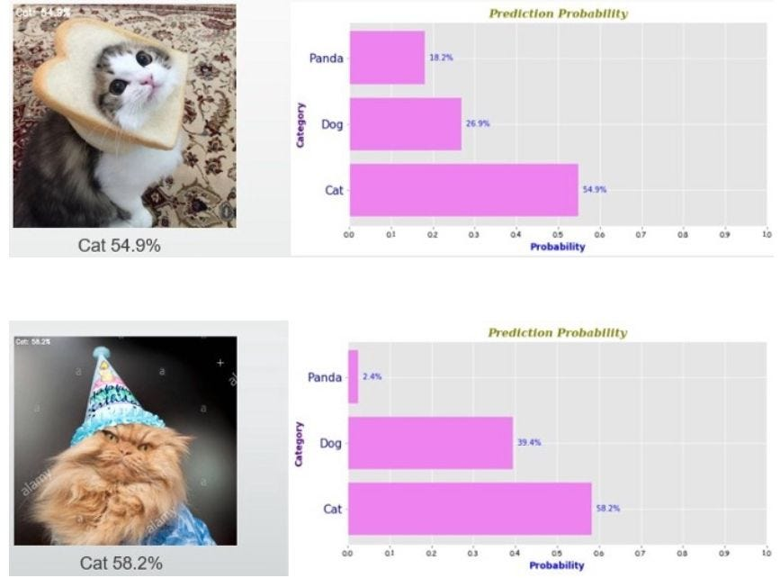

Image Recognition
What is the probability that there is a cat in the image ?
$P\left(Cat \right|Image)=P\left(Cat \right| pixel_{1}, pixel_{2},⋯, pixel_{n})$
Figure taken from medium

Slide 5
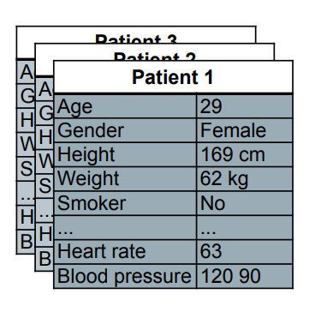
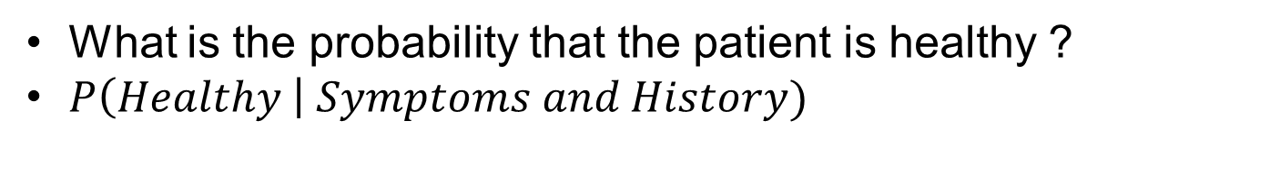
Classification
What is the probability that the patient is healthy ?
$P\left(Healthy \right| Symptoms and History)$
Figure taken from DeepLearning.AI

Slide 6
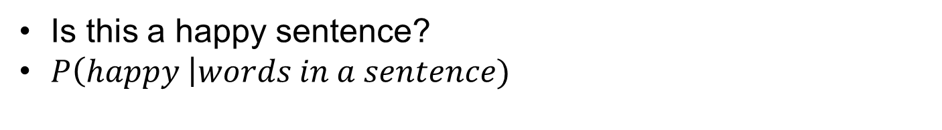
Sentimental Analysis
Is this a happy sentence?
$P\left(happy \right|words in a sentence)$

Slide 7
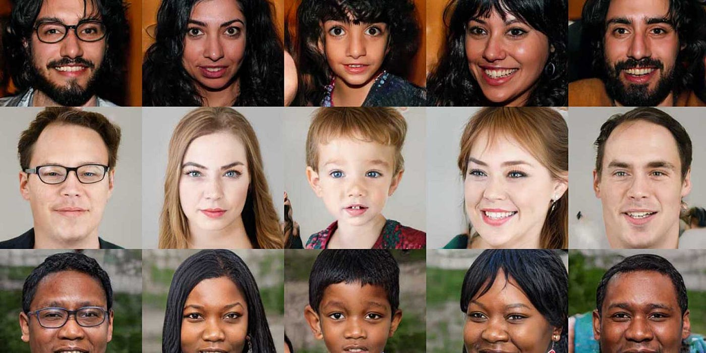
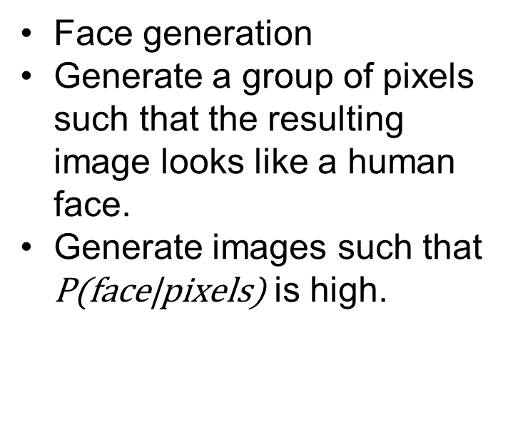
Generative Models
Face generation
Generate a group of pixels such that the resulting image looks like a human face.
Generate images such that $\text{P}\text{(}\text{face}\text{|}\text{pixels}\text{)}$ is high.
Figure taken from medium

Slide 8
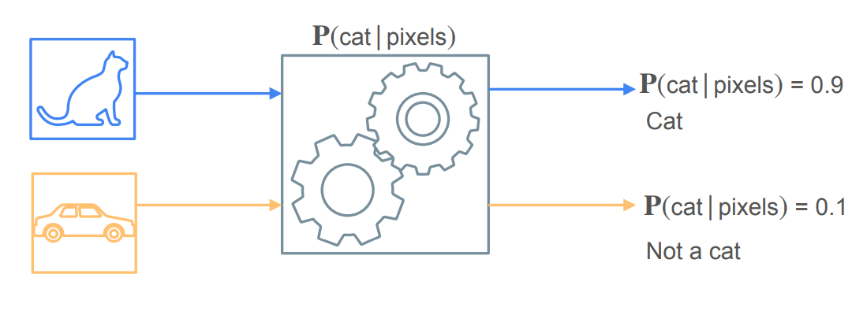
Machine Learning Model
Figure taken from DeepLearning.AI

Slide 9
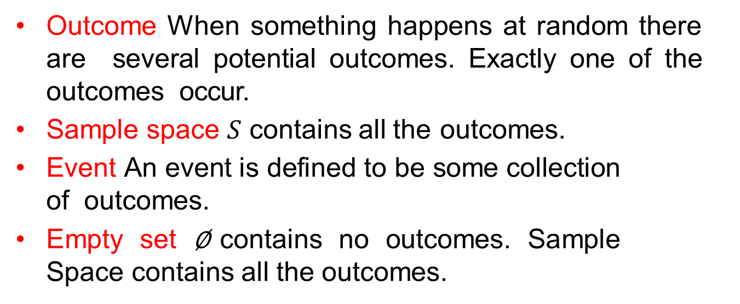
Key Terms
Outcome When something happens at random there are several potential outcomes. Exactly one of the outcomes occur.
Sample space $S$ contains all the outcomes.
Event An event is defined to be some collection of outcomes.
Empty set $\text{∅}$contains no outcomes. Sample Space contains all the outcomes.

Slide 10
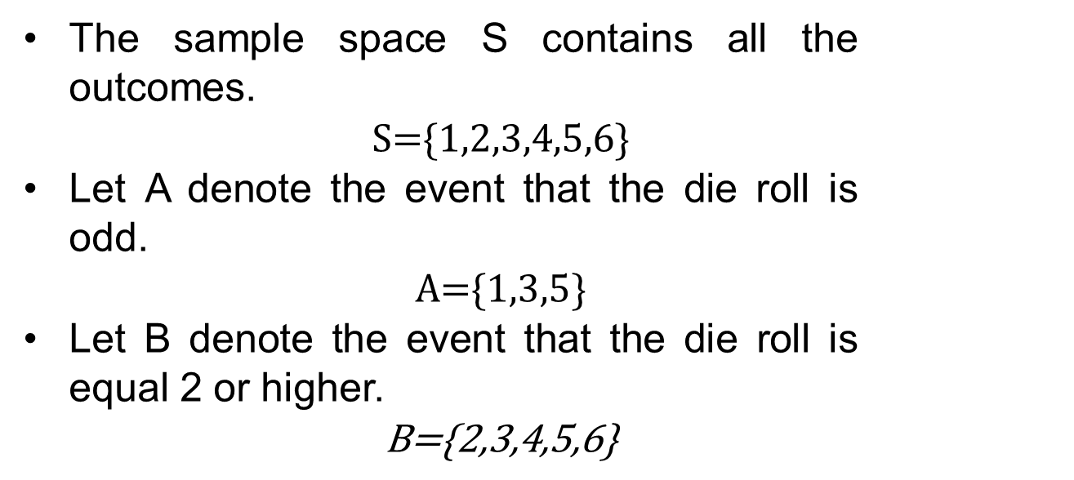
Rolling a six sided dice
The sample space S contains all the outcomes.
$\text{S}\text{=\{1,2,3,4,5,6\}}$
Let A denote the event that the die roll is odd.
$\text{A}\text{=\{1,3,5\}}$
Let B denote the event that the die roll is equal 2 or higher.
$\text{B}\text{=\{2,3,4,5,6\}}$

Slide 11
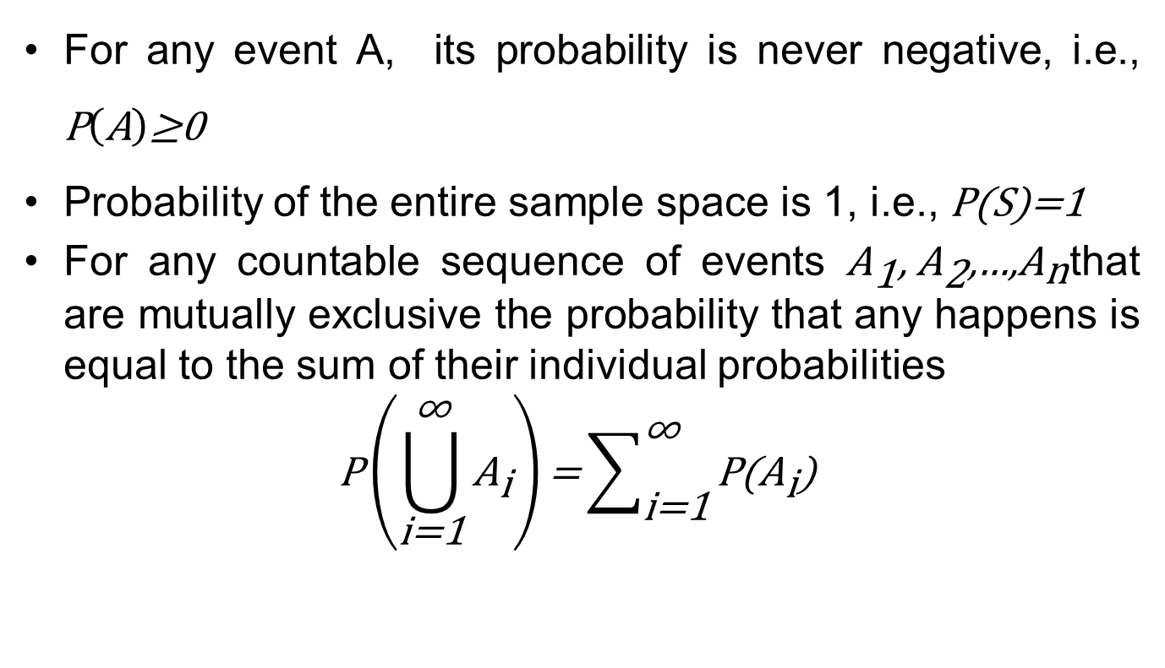
Axioms of Probability
For any event A, its probability is never negative, i.e., $\text{P}\left(\text{A}\right)\text{≥0}$
Probability of the entire sample space is 1, i.e., $\text{P}\text{(}\text{S}\text{)=1}$
For any countable sequence of events ${\text{A}}_{\text{1}}\text{, }{\text{A}}_{\text{2}}\text{,…,}{\text{A}}_{\text{n}}$that are mutually exclusive the probability that any happens is equal to the sum of their individual probabilities
$$\text{P}\left(\bigcup_{\text{i}\text{=1}}^{\text{∞}}{{\text{A}}_{\text{i}}}\right)\text{=}\sum_{\text{i}\text{=1}}^{\text{∞}}{\text{P}\text{(}{\text{A}}_{\text{i}}\text{)}}$$

Slide 12
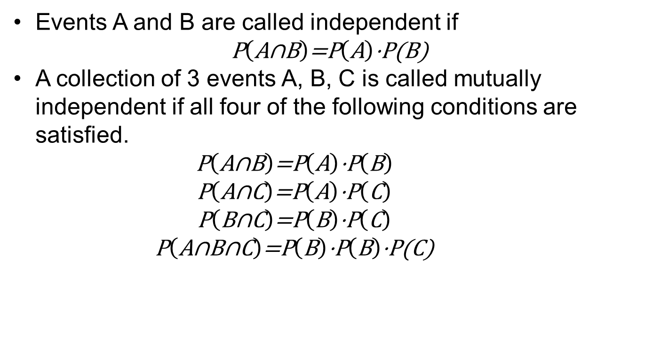
Independence of Events
Events A and B are called independent if
$$\text{P}\left(\text{A}\text{∩}\text{B}\right)\text{=}\text{P}\left(\text{A}\right)\text{⋅}\text{P}\text{(}\text{B}\text{)}$$
A collection of 3 events A, B, C is called mutually independent if all four of the following conditions are satisfied.
$$\text{P}\left(\text{A}\text{∩}\text{B}\right)\text{=}\text{P}\left(\text{A}\right)\text{⋅}\text{P}\left(\text{B}\right)$$
$$\text{P}\left(\text{A}\text{∩}\text{C}\right)\text{=}\text{P}\left(\text{A}\right)\text{⋅}\text{P}\left(\text{C}\right)$$
$$\text{P}\left(\text{B}\text{∩}\text{C}\right)\text{=}\text{P}\left(\text{B}\right)\text{⋅}\text{P}\left(\text{C}\right)$$
$$\text{P}\left(\text{A}\text{∩}\text{B}\text{∩}\text{C}\right)\text{=}\text{P}\left(\text{B}\right)\text{⋅}\text{P}\left(\text{B}\right)\text{⋅}\text{P}\text{(}\text{C}\text{)}$$

Slide 13
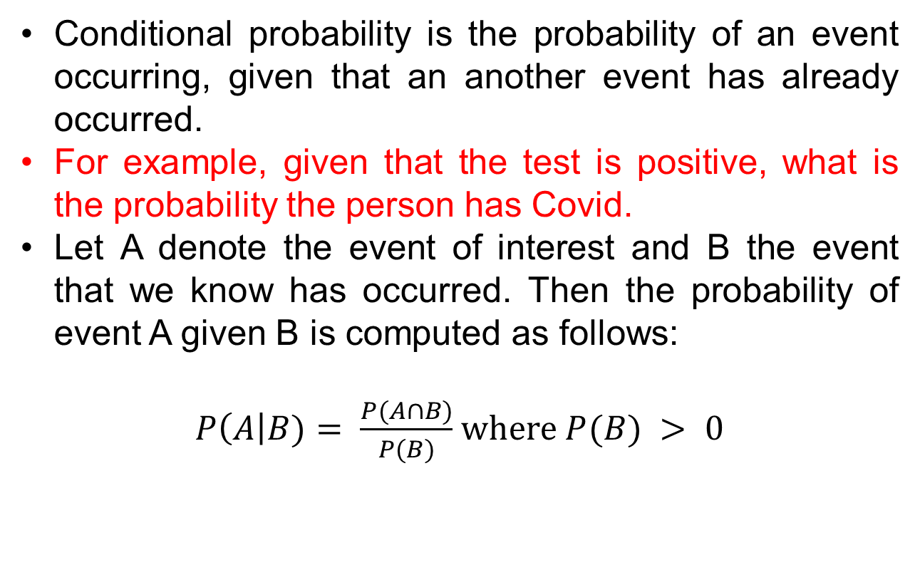
Conditional Probability
Conditional probability is the probability of an event occurring, given that an another event has already occurred.
For example, given that the test is positive, what is the probability the person has Covid.
Let A denote the event of interest and B the event that we know has occurred. Then the probability of event A given B is computed as follows:
$P\left(A\right|B)= \frac{P(A∩B)}{P(B)}$ where $P(B) > 0$

Slide 14
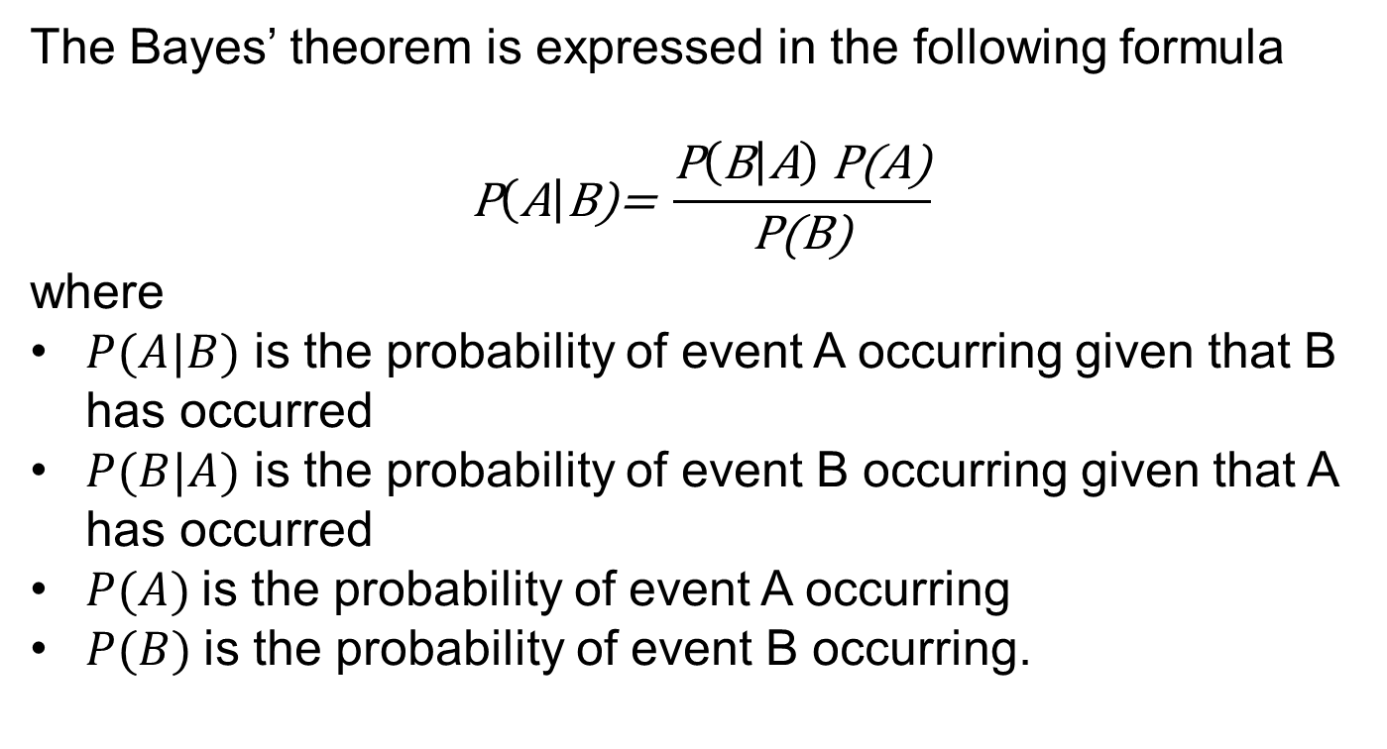
Bayes Theorem
The Bayes’ theorem is expressed in the following formula
$$\text{P}\left(\text{A}\right|\text{B}\text{)= }\frac{\text{P}\left(\text{B} | \text{A}\right) \text{P}\text{(}\text{A}\text{)}}{\text{P}\text{(}\text{B}\text{)}}$$
where
$P(A|B)$ is the probability of event A occurring given that B has occurred
$P(B|A)$ is the probability of event B occurring given that A has occurred
$P(A)$is the probability of event A occurring
$P(B)$is the probability of event B occurring.

Slide 15
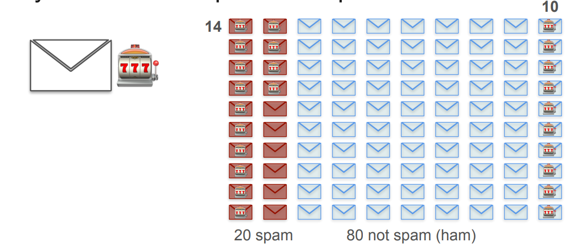
Example - Spam Classification
What is the probability that an email containing lottery is a spam?
Figure taken from DeepLearning.AI

Slide 16
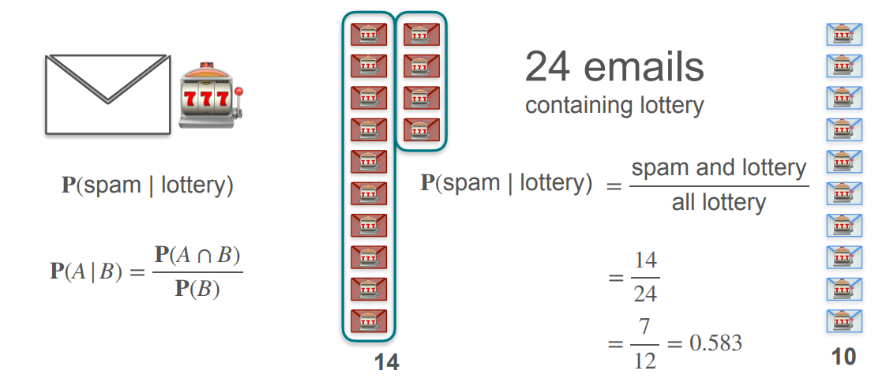
Spam Classification - Intuitive Solution
Figure taken from DeepLearning.AI

Slide 17
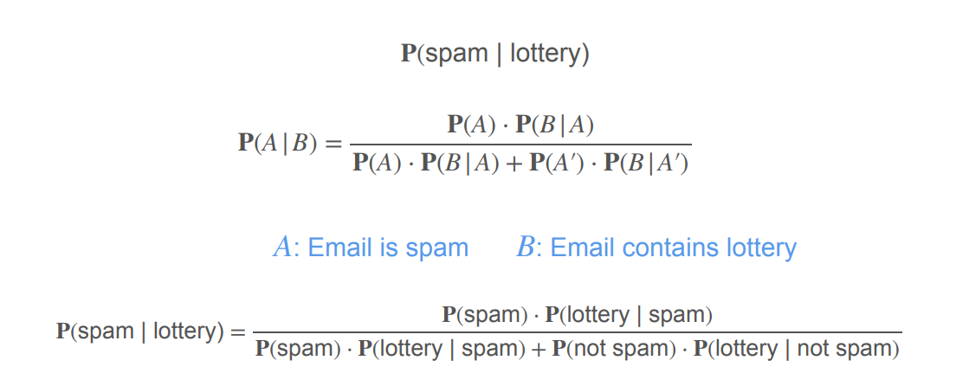
Spam Classification – Bayes Theorem
Figure taken from DeepLearning.AI

Slide 18
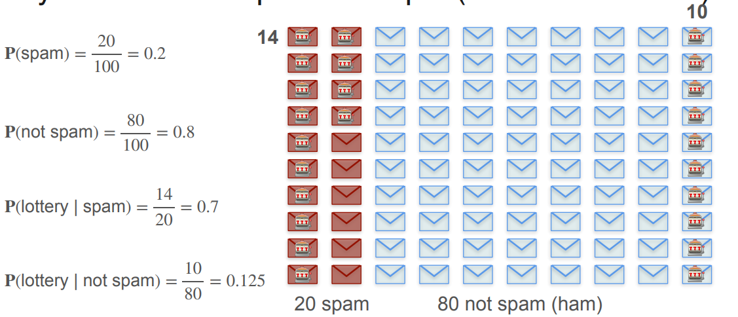
Spam Classification – Bayes Theorem
Figure taken from DeepLearning.AI

Slide 19
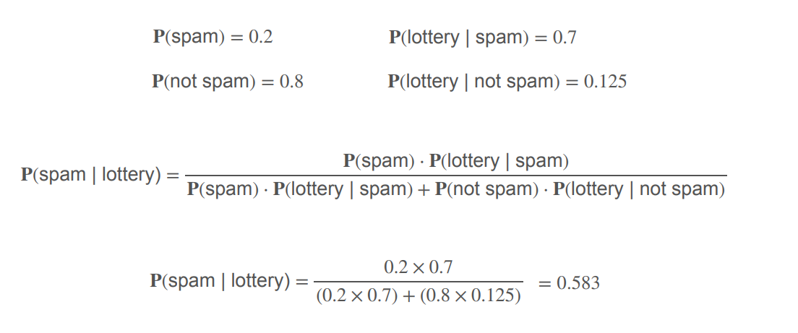
Spam Classification – Bayes Theorem
Figure taken from DeepLearning.AI

Slide 20
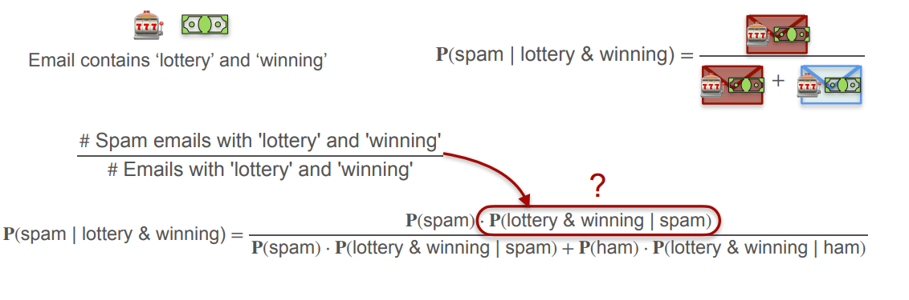
Spam Classification – Naïve Bayes Theorem
What is the probability that an email containing lottery and winning is a spam?
Figure taken from DeepLearning.AI

Slide 21
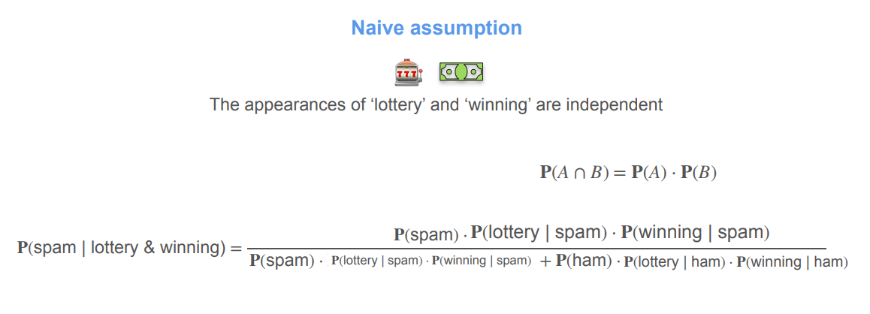
Spam Classification – Naïve Bayes Theorem
What is the probability that an email containing lottery and winning is a spam?
Figure taken from DeepLearning.AI

Slide 22
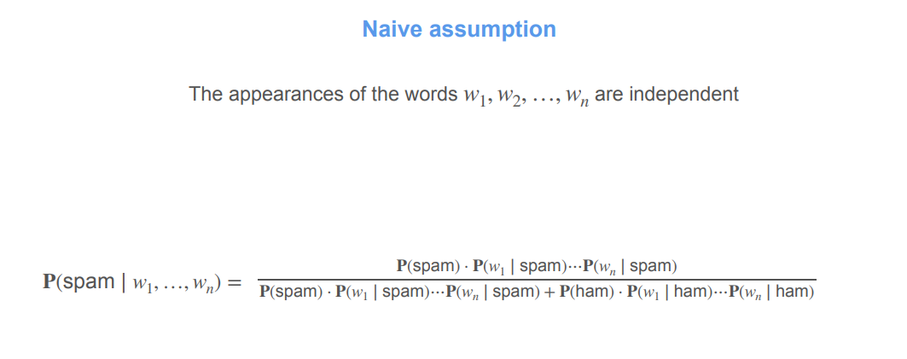
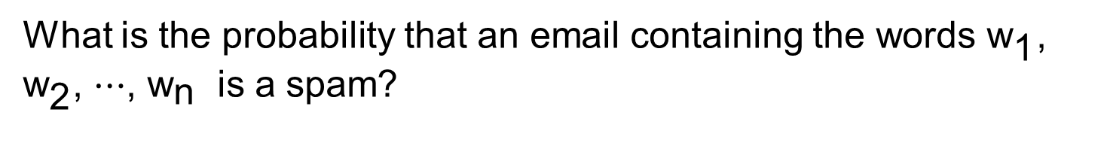
Spam Classification – Naïve Bayes Theorem
What is the probability that an email containing the words ${\text{w}}_{\text{1}}\text{, }{\text{w}}_{\text{2}}\text{, ⋯, }{\text{w}}_{\text{n}}$ is a spam?
Figure taken from DeepLearning.AI

Slide 23
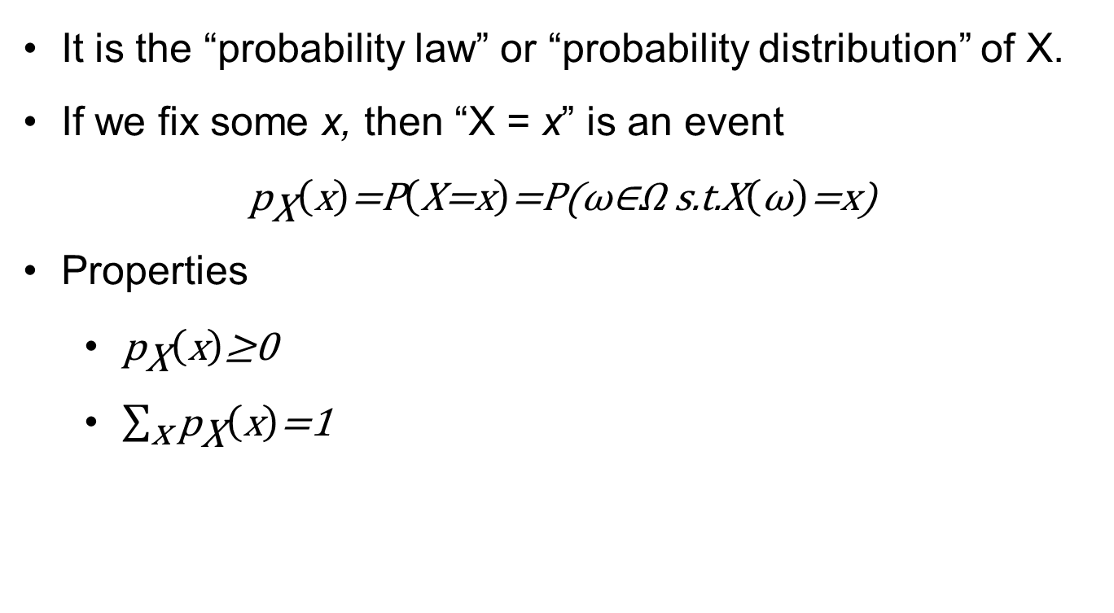
Probability mass function of a discrete r.v
It is the “probability law” or “probability distribution” of X.
If we fix some x, then “X = x” is an event
$${\text{p}}_{\text{X}}\left(\text{x}\right)\text{=}\text{P}\left(\text{X}\text{=}\text{x}\right)\text{=}\text{P}\text{(}\text{ω}\text{∈}\text{Ω} \text{s}\text{.}\text{t}\text{.}\text{X}\left(\text{ω}\right)\text{=}\text{x}\text{)}$$
Properties
${\text{p}}_{\text{X}}\left(\text{x}\right)\text{≥0}$
$\sum_{\text{x}}{{\text{p}}_{\text{X}}\left(\text{x}\right)\text{=1}}$

Slide 24
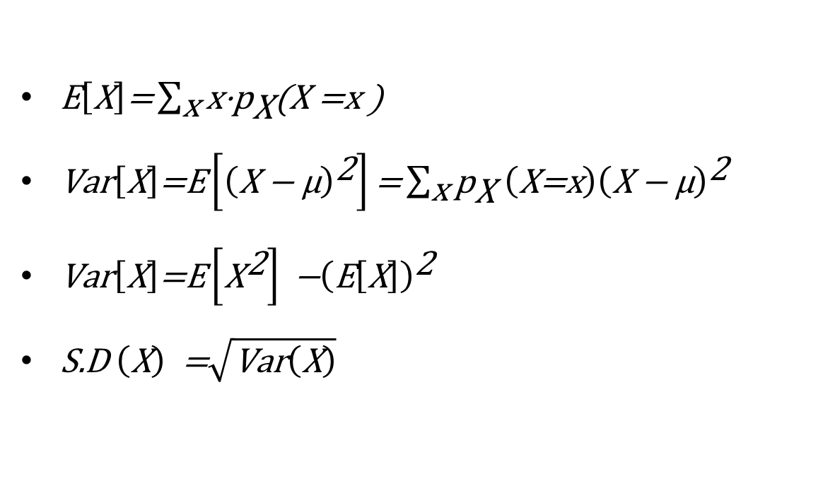
Expectation, Variance, Standard Deviation
$\text{E}\left[\text{X}\right]\text{=}\sum_{\text{x}}{\text{x}\text{⋅}{\text{p}}_{\text{X}}\text{(}\text{X}\text{ =}\text{x}\text{ ) }}$
$\text{Var}\left[\text{X}\right]\text{=}\text{E}\left[{\left(\text{X}\text{ − }\text{μ}\right)}^{\text{2}}\right]\text{=}\sum_{\text{x}}{{\text{p}}_{\text{X}} \left(\text{X}\text{=}\text{x}\right){\left(\text{X}\text{ − }\text{μ}\right)}^{\text{2}}}$
$\text{Var}\left[\text{X}\right]\text{=}\text{E}\left[{\text{X}}^{\text{2}}\right]\text{ −}{\left(\text{E}\left[\text{X}\right]\right)}^{\text{2}}$
$\text{S}\text{.}\text{D} \left(\text{X}\right) \text{=}\sqrt{\text{Var}\left(\text{X}\right)}$

Slide 25
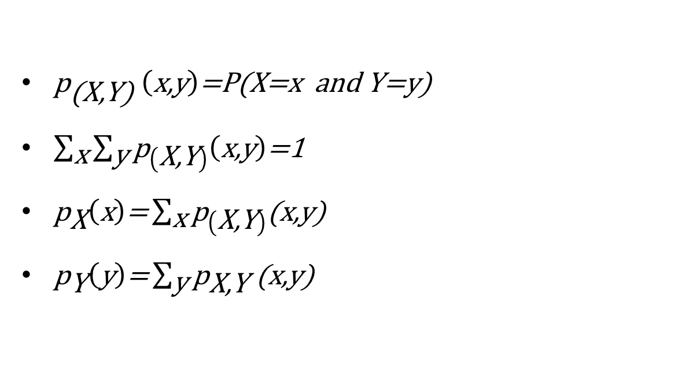
Joint PMF and Marginal PMF
${\text{p}}_{\text{(}\text{X}\text{,}\text{Y}\text{)}} \left(\text{x}\text{,}\text{y}\right)\text{=}\text{P}\text{(}\text{X}\text{=}\text{x} \text{and} \text{Y}\text{=}\text{y}\text{)}$
$\sum_{\text{x}}{\sum_{\text{y}}{{\text{p}}_{\left(\text{X}\text{,}\text{Y}\right)}\left(\text{x}\text{,}\text{y}\right)\text{=1 }}}$
${\text{p}}_{\text{X}}\left(\text{x}\right)\text{=}\sum_{\text{x}}{{\text{p}}_{\left(\text{X}\text{,}\text{Y}\right)}\text{(}\text{x}\text{,}\text{y}\text{) }}$
${\text{p}}_{\text{Y}}\left(\text{y}\right)\text{=}\sum_{\text{y}}{{\text{p}}_{\text{X}\text{,}\text{Y}}\text{ (}\text{x}\text{,}\text{y}\text{)}}$

Slide 26

Independence and Conditional PMF
${\text{p}}_{\text{(}\text{X}\left|\text{Y}\right)}\left(\text{x} | \text{y}\right)\text{=}\frac{{\text{p}}_{\text{X}\text{,}\text{Y}}\text{(}\text{x}\text{,}\text{y}\text{) }}{{\text{p}}_{\text{Y}}\text{(}\text{y}\text{)}}$
${\text{p}}_{\text{Y}}\left(\text{y}\right) {\text{p}}_{\text{(}\text{X}\text{|}\text{Y}\text{)}} \left(\text{x} | \text{y}\right)\text{=}{\text{p}}_{\text{X}\text{,}\text{Y}}\text{(}\text{x}\text{,}\text{y}\text{)}$
${\text{p}}_{\text{X}}\left(\text{x}\right) {\text{p}}_{\text{(}\text{Y}\text{|}\text{X}\text{)}} \left(\text{y} | \text{x}\right)\text{=}{\text{p}}_{\text{X}\text{,}\text{Y}}\text{(}\text{x}\text{,}\text{y}\text{)}$
${\text{p}}_{\text{X}}\left(\text{x}\right) {\text{p}}_{\text{(}\text{Y}\text{)}} \left(\text{y}\right)\text{=}{\text{p}}_{\text{X}\text{,}\text{Y}}\left(\text{x}\text{,}\text{y}\right)$
${\text{p}}_{\left(\text{Y} | \text{X}\right)}\left(\text{y} | \text{x}\right)\text{=}{\text{p}}_{\text{X}\left(\text{x}\right)}$

Slide 27
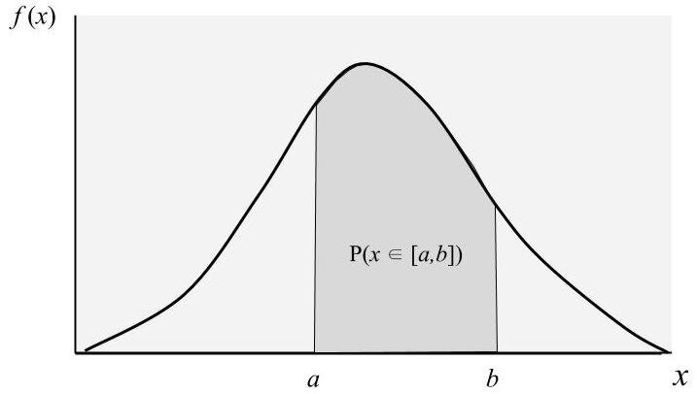




Probability Density Function (PDF) of a continuous r.v

Slide 28




Joint and Marginal PDF

Slide 29
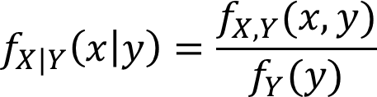
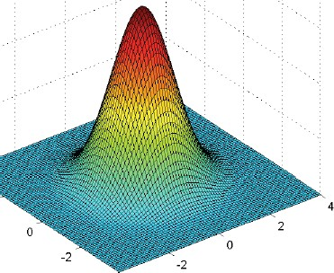
Conditional PDF

Slide 30
Common Probability Distributions
Discrete
Discrete Uniform
Bernoulli
Binomial
Poisson
Continuous
Continuous Uniform
Normal
Exponential

Slide 31
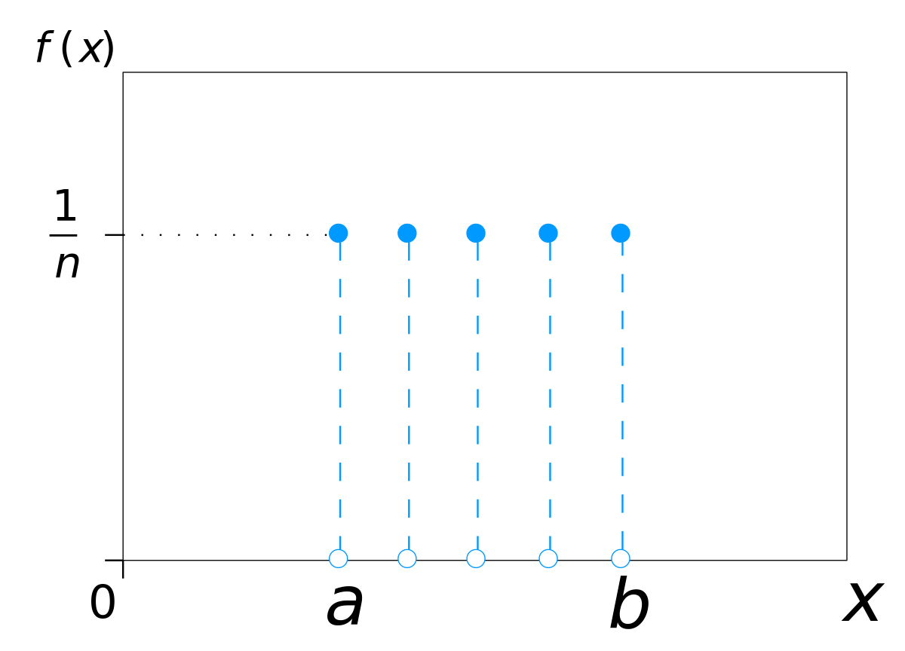
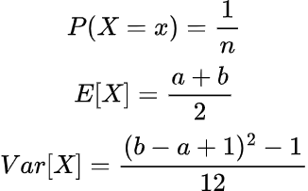
Discrete Uniform Distribution
Figure taken from Wikipedia

Slide 32
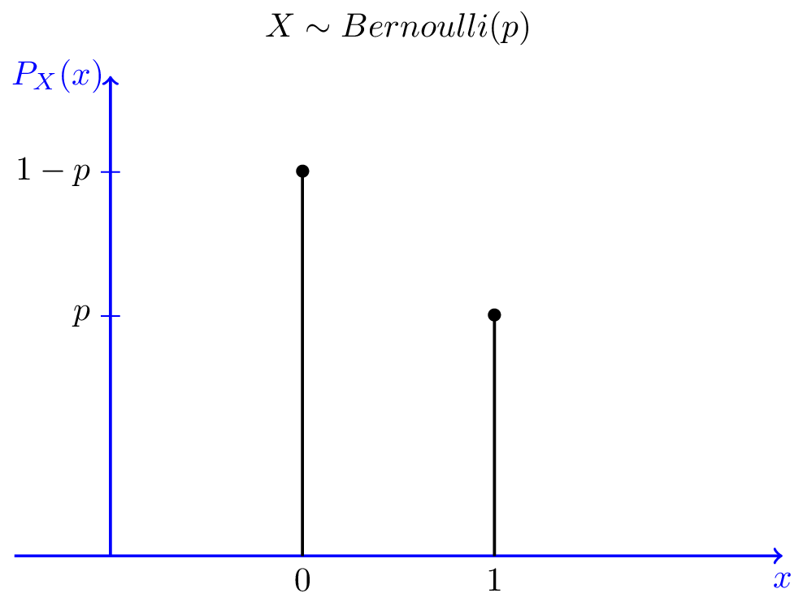


Bernoulli Distribution
Figure taken from Probability Course

Slide 33
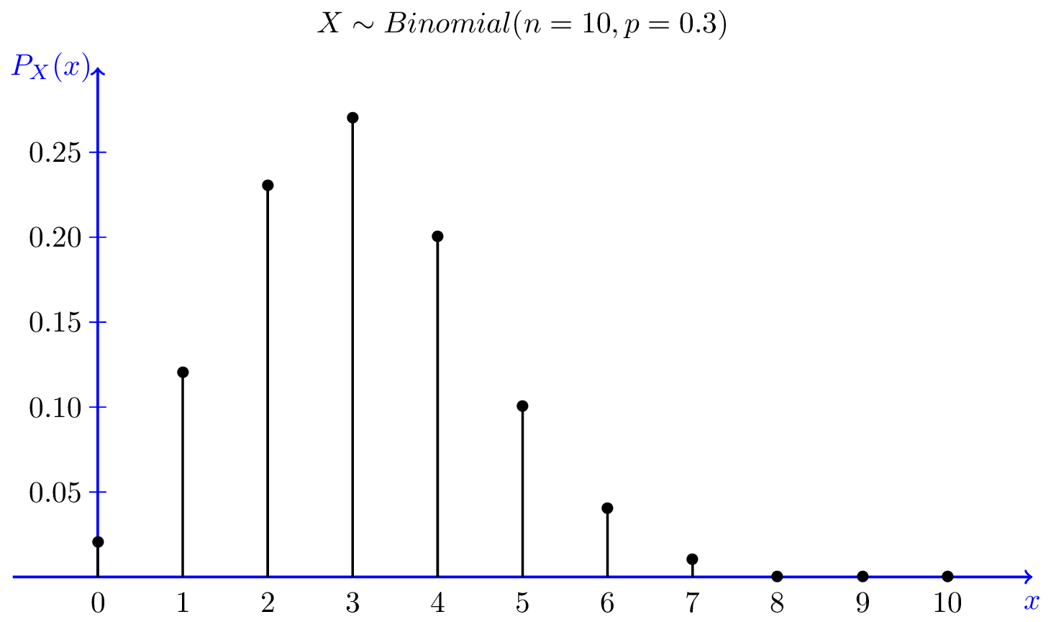
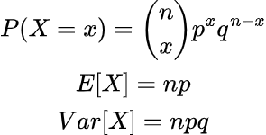
Binomial Distribution
Figure taken from Probability Course

Slide 34
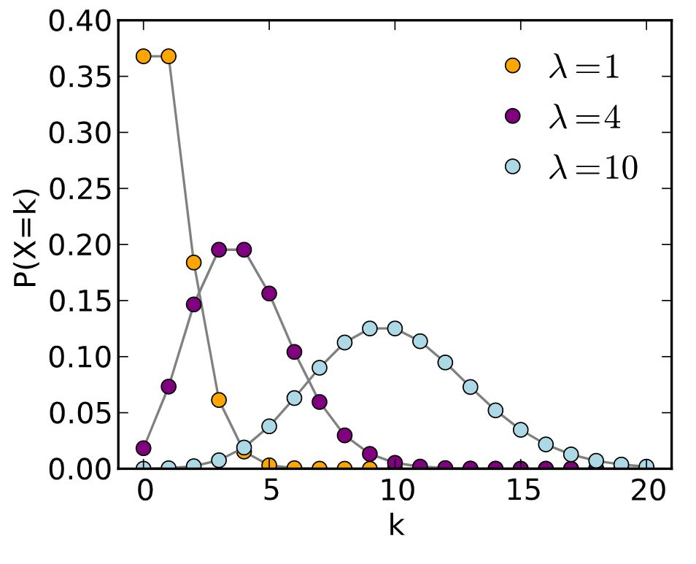
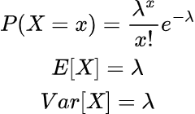
Poisson Distribution
Figure taken from Wikipedia

Slide 35
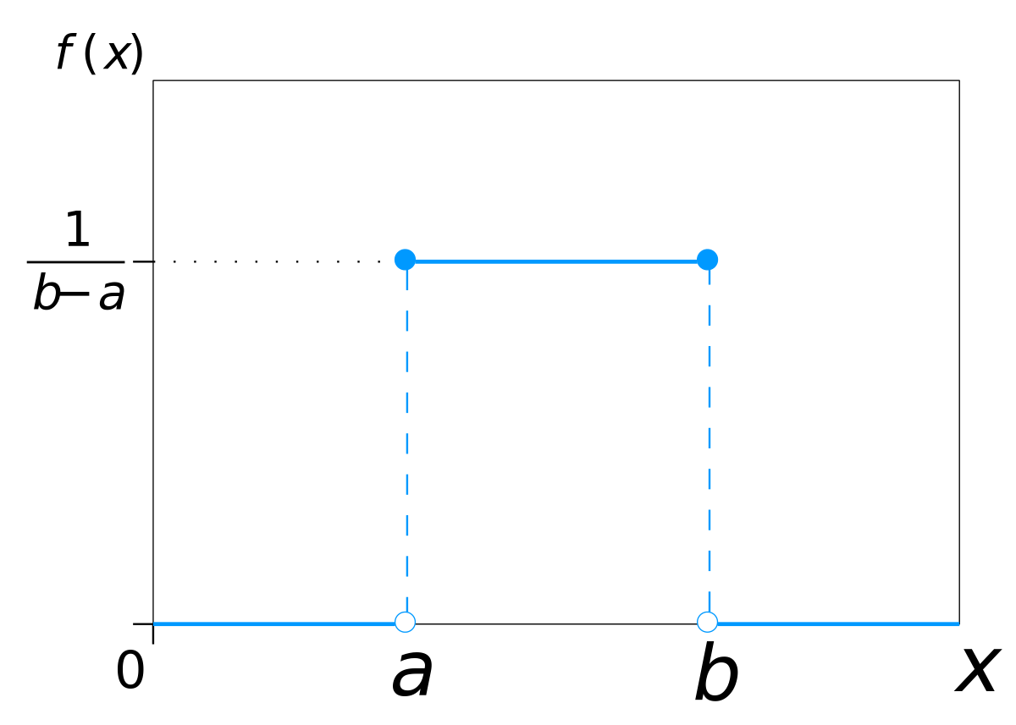
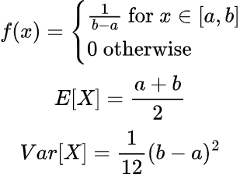
Continuous Uniform Distribution
Figure taken from Probability Course

Slide 36
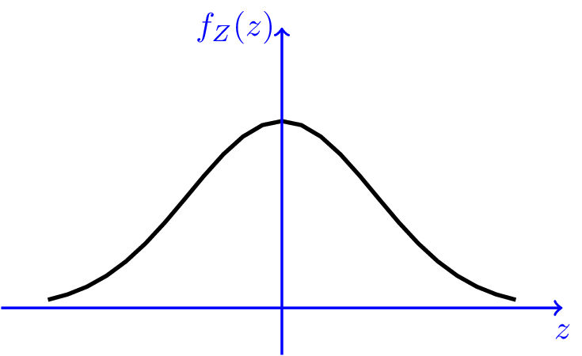
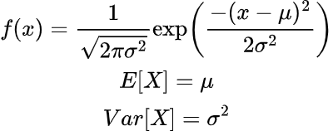
Gaussian Distribution
Figure taken from Probability Course

Slide 37
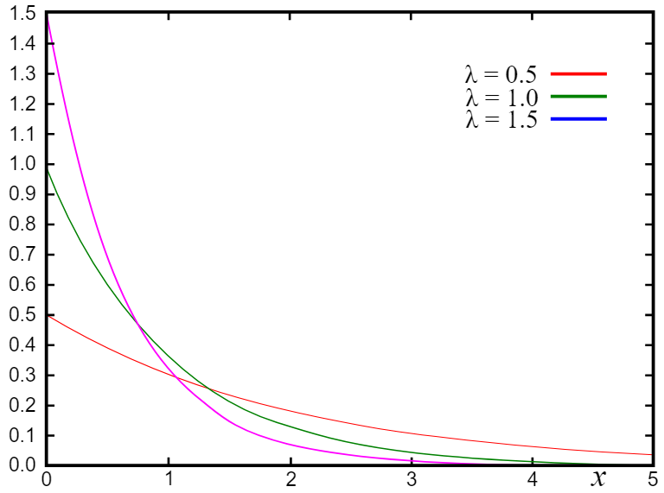
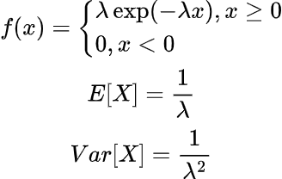
Exponential Distribution
Figure taken from Wikipedia

Slide 38
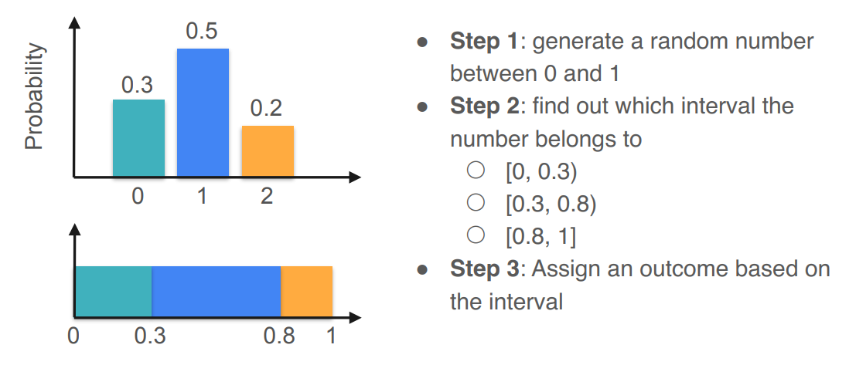
Sampling from a Distribution
Figure taken from DeepLearning.AI

Slide 39
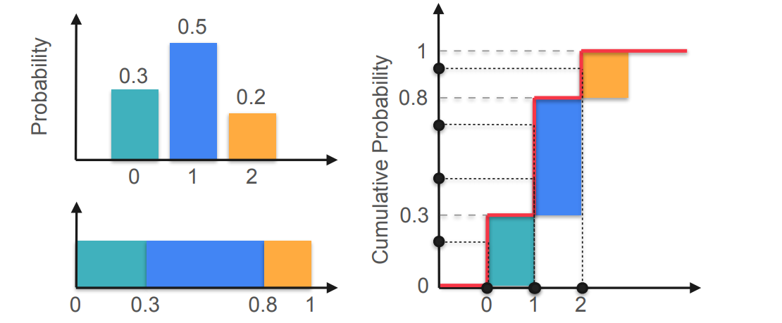
Sampling from a Distribution
Figure taken from DeepLearning.AI

Slide 40
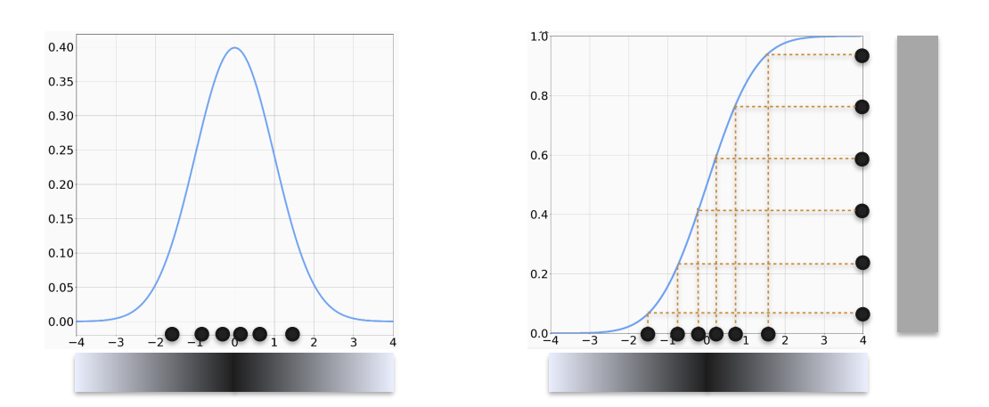
Sampling from a Distribution
Figure taken from DeepLearning.AI

